Slide 1
STEGANOGRAPHY VS CRYPTOGRAPHY
Subject: Cryptography and Network Security
Name: Mohammed Arshad R
Reg No: 192521126

Slide 2
FUNDAMENTAL PARADIGMS OF SECURITY
Cryptography Paradigm
The science of altering content intelligibility to prevent unauthorized access.
Objective: Render data completely unreadable to interceptors.
Focus: Obscurity of data meaning via encryption keys.
Evidence: Ciphertext is visible but mathematically complex.
Steganography Paradigm
The science of altering visual or logical presence to prevent interception detection.
Objective: Conceal the actual existence of communication.
Focus: Hiding payloads inside innocent carrier media.
Evidence: Cover asset remains completely normal to sensory checks.

Slide 3
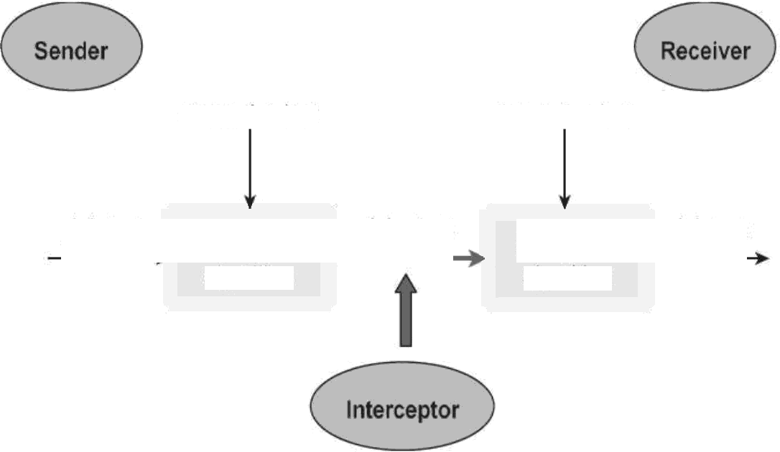
CRYPTOGRAPHIC ARCHITECTURE & FLOW
Mathematical Encryption
Ensures confidentiality by transforming readable plain states to unreadable cipher states.
encryption key
decryption key
Key Dependency: Uses symmetric or asymmetric key parameters.
Structure: Relies on mathematical equations ($C = E(P, K)$).
Alert Factor: Highly scrambled ciphertext can attract targeted attacks.
plaintext
Encryption algorithm
ciphertext
Decryption algorithm
plaintext

Slide 4
Original Image
STE GANO GRAPHI C MECHANISM
11111111 88888888
11111111 tt88888t
11111111 tt8888tt
Sub-Visual Cover Embedding
Hides secret bits of a payload inside non-essential bits of a digital cover image (LSB replacement).
Stego Image
No Obvious Alteration: Change in carrier bytes is imperceptible.
Dynamic Capacity: Depends on host resolution boundaries.
11111181 | 00888811
88808818 | 00888881
11111100 | 00088811
11111181 | 00800801
80800001 | 11111100

Slide 5
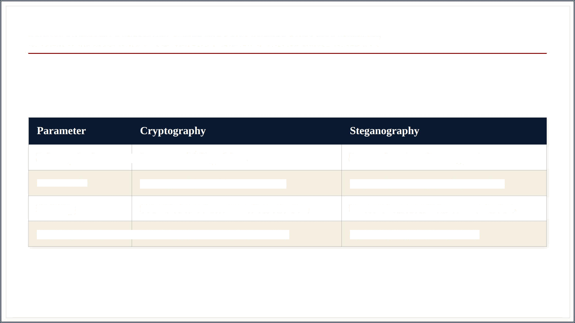
STE GANO GRAPHY VS CRYPTOGRAPHY COMPARISON
Primary Goal
Prevent readability of data.
Prevent detection of message existence.
Carrier File
Not required (scrambles source text).
Required (host image, audio, or video).
Visibility
Scrambled text draws immediate attention.
Innocent host asset hides communication.
Key Requirement
Mandatory (Symmetric/Asymmetric).
Optional (Stego-key is optional).

Slide 6
HYBRID SECURITY SYSTEMS: DUAL LAYER DEFENSE
Chaining Protocols
For high-security operations, combining both techniques eliminates isolated structural weaknesses.
First Layer: Plaintext is first encrypted using modern algorithms (AES-256) to secure meaning.
Second Layer: The resulting ciphertext is then embedded inside a cover carrier (image or audio).
Outcome: If the steganography layer is detected, the adversary still faces mathematically solid encryption.

